Slide 1

DUSTLESS DUSTER

Slide 2

WHEN WE ERASE BLACKBOARD WITH DUSTER, TWO THINGS HAPPEN
WE CLEAN THE BLACKBOARD.
WE POLLUTE THE ATMOSPHERE OF CLASSROOM WITH CHALK DUST.

Slide 3
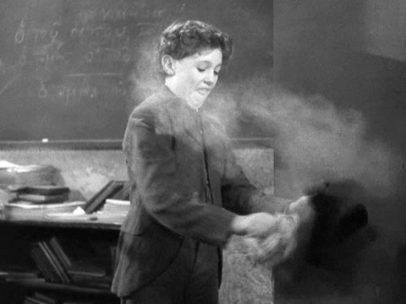

Slide 4

According to
American Academy of Allergy, Asthma and Immunology(AAAAI) and
International Journal of Medical and Health Sciences
Chalk dust is recognised as one of the irratants that could trigger asthma and allergy attacks, including coughing, wheezing, rashes, and eye irritation.

Slide 5
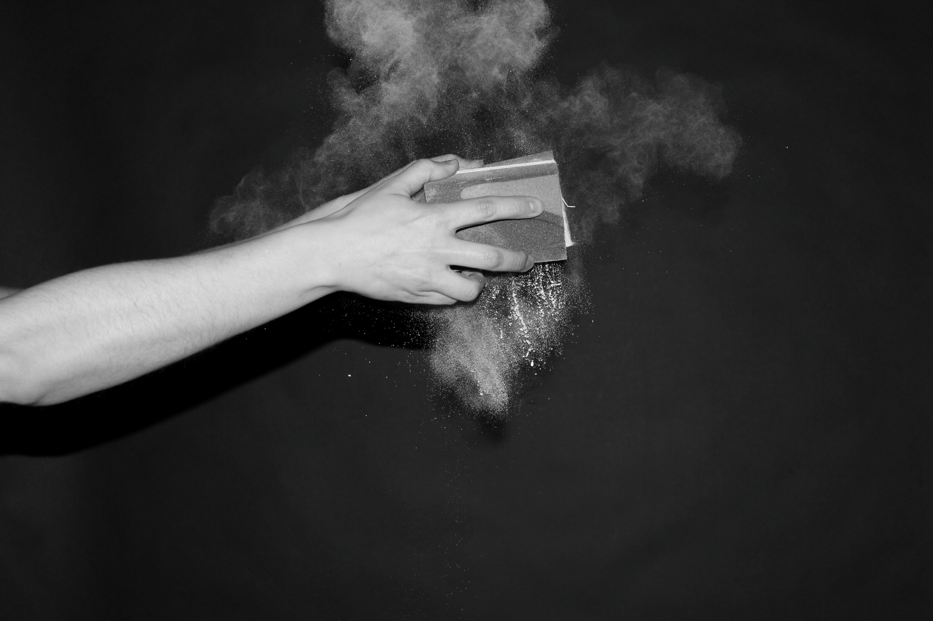
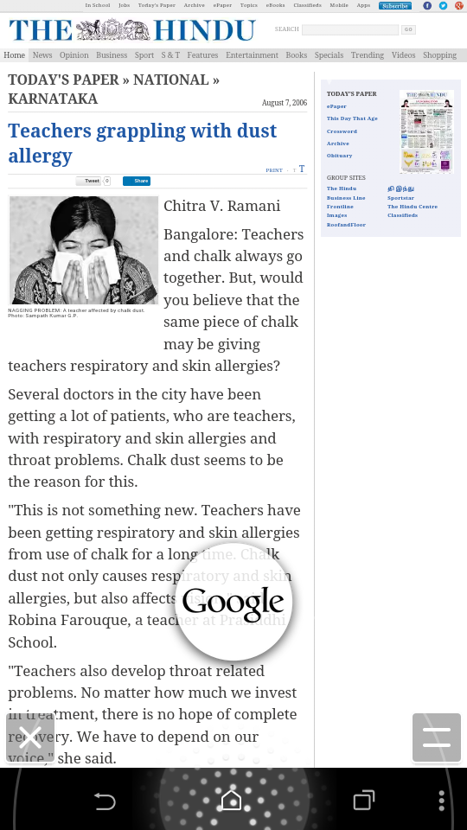

Slide 6
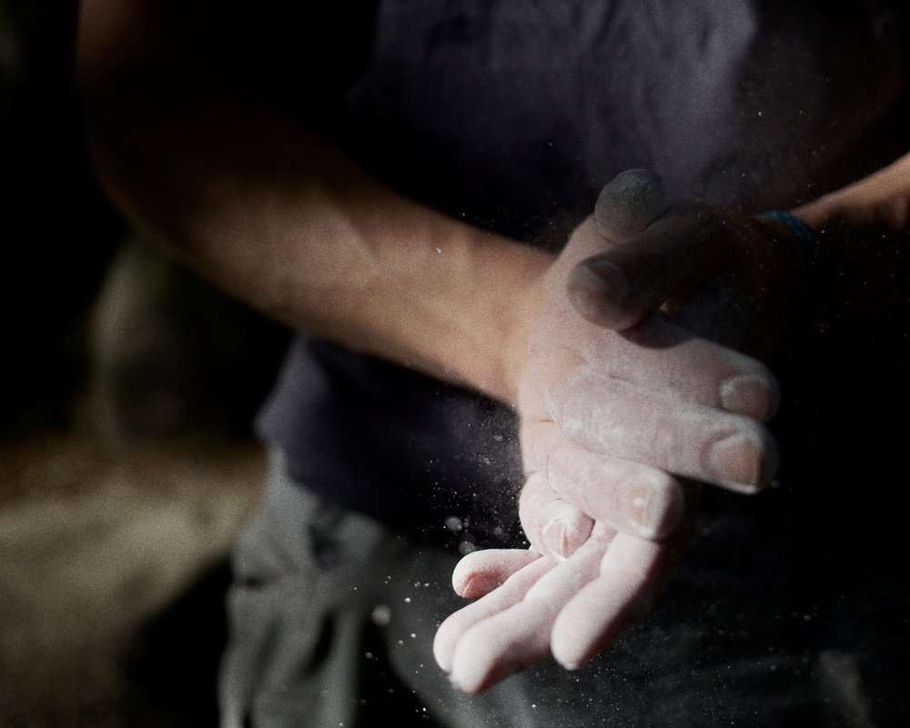
SOLUTION ??

Slide 7

A duster with a mini vaccum cleaner fitted inside it which can absorb all the dust can be a solution

Slide 8

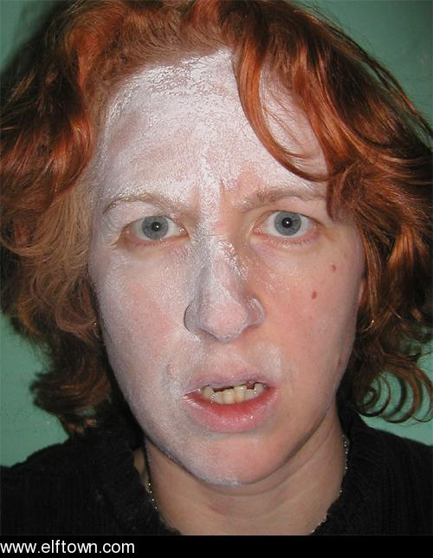
So after the class teachers do not look like

